Slide 1
Kronogram
Harry Bos
Anna Huisinga
Kasey Nagle
Nicholas Vanhaute

Slide 2
Project Focus
We have shifted our project focus from maintaining social media presence to reliving memories. We will focus on the timeline, daily feed, and social media aggregation parts of the project. We feel this will help solidify the purpose of the project and erase some questions. We have also changed our name to Kronogram (Krono) to better express what our app will be used for.

Slide 3
Sprint Goal
The main objectives for this sprint were:
Have a login for users working
Have users be able to login to their various social media accounts
Receive data from Twitter, Facebook, and Instagram API requests
Have a basic backend working

Slide 4
Major Sprint Achievements
We have completed the login experience along with logins for the three social media sources we are using.
We have successfully registered our app and made basic API calls to the three social medias platforms.
We have implemented a fundamental UI flow for the app.

Slide 5
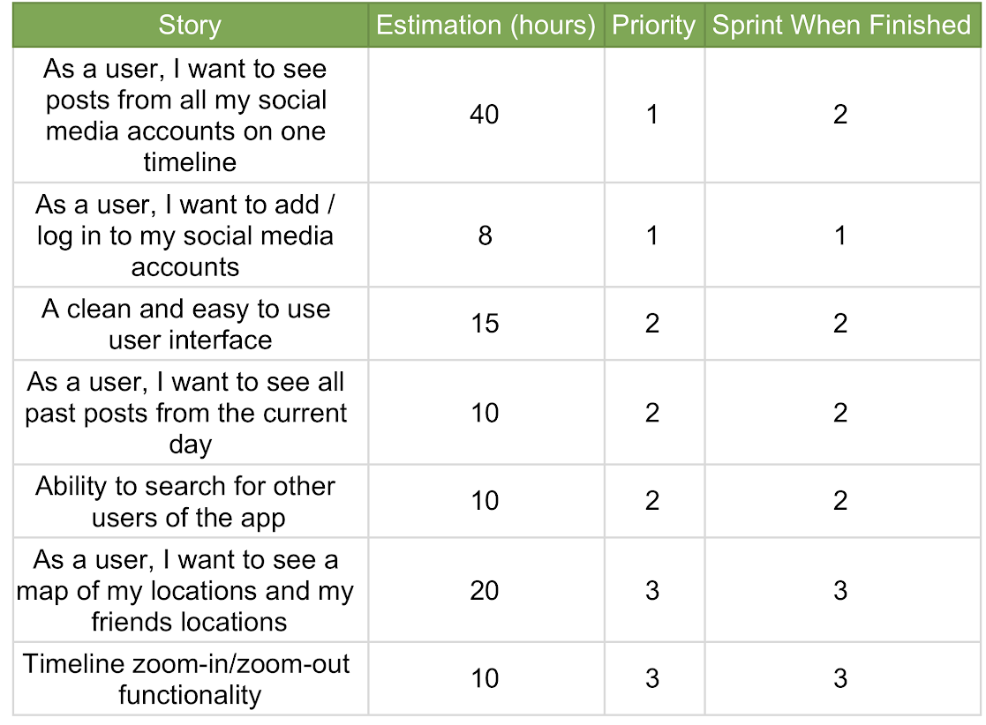
Project Backlog

Slide 6
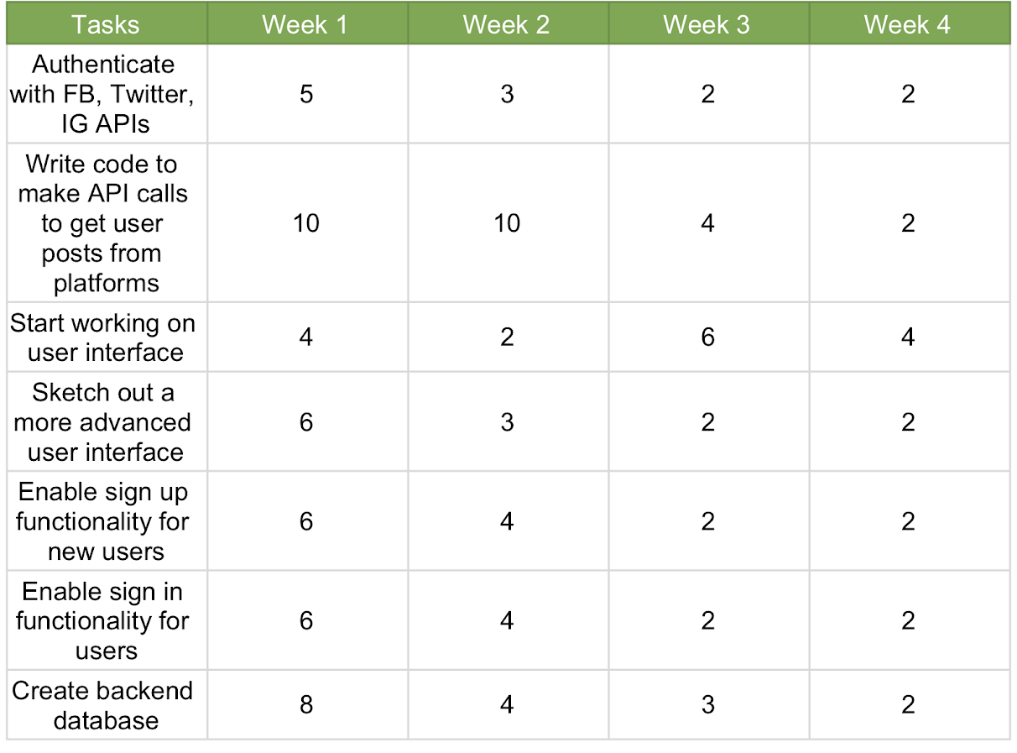
Sprint Backlog

Slide 7
Not Completed / Lessons Learned
Still needs work:
The Twitter class currently doesn’t differentiate between normal and extended tweets.
The backend database needs to enforce unique usernames and reject sign up attempts with usernames that are already in use.
We need to flesh out the UI and add test cases for interface components.
We need to add test cases for our business logic classes.
Lessons:
Facebook API documentation is terrible.
Architecture should be planned far in advance.
Asynchronous method calls should be handled with care.

Slide 8
Demo
We will first show our staging branch where our functionality is being worked on and tested.
We will then show the UI layout that Kasey has been working on.
Combining them is a Sprint 2 goal.

